Slide 1
Interview Question

Slide 2
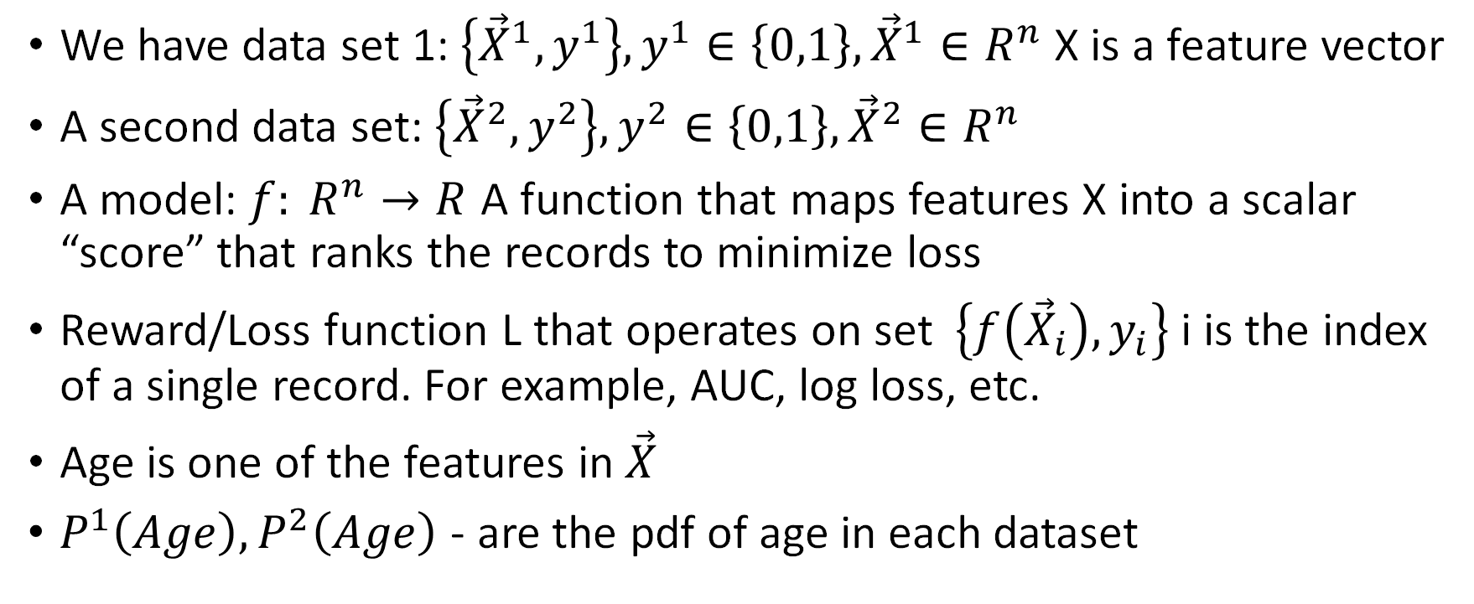
Model validation
We have data set 1: $\left\{{\vec{X}}^{1},y^{1}\right\},y^{1}∈\left\{0,1\right\},{\vec{X}}^{1}∈R^{n}$ X is a feature vector
A second data set: $\left\{{\vec{X}}^{2},y^{2}\right\},y^{2}∈\left\{0,1\right\},{\vec{X}}^{2}∈R^{n}$
A model: $f: R^{n}→R$ A function that maps features X into a scalar “score” that ranks the records to minimize loss
Reward/Loss function L that operates on set $\left\{f\left({\vec{X}}_{i}\right), y_{i}\right\}$ i is the index of a single record. For example, AUC, log loss, etc.
Age is one of the features in $\vec{X}$
$P^{1}\left(Age\right),P^{2}\left(Age\right)$ - are the pdf of age in each dataset

Slide 3
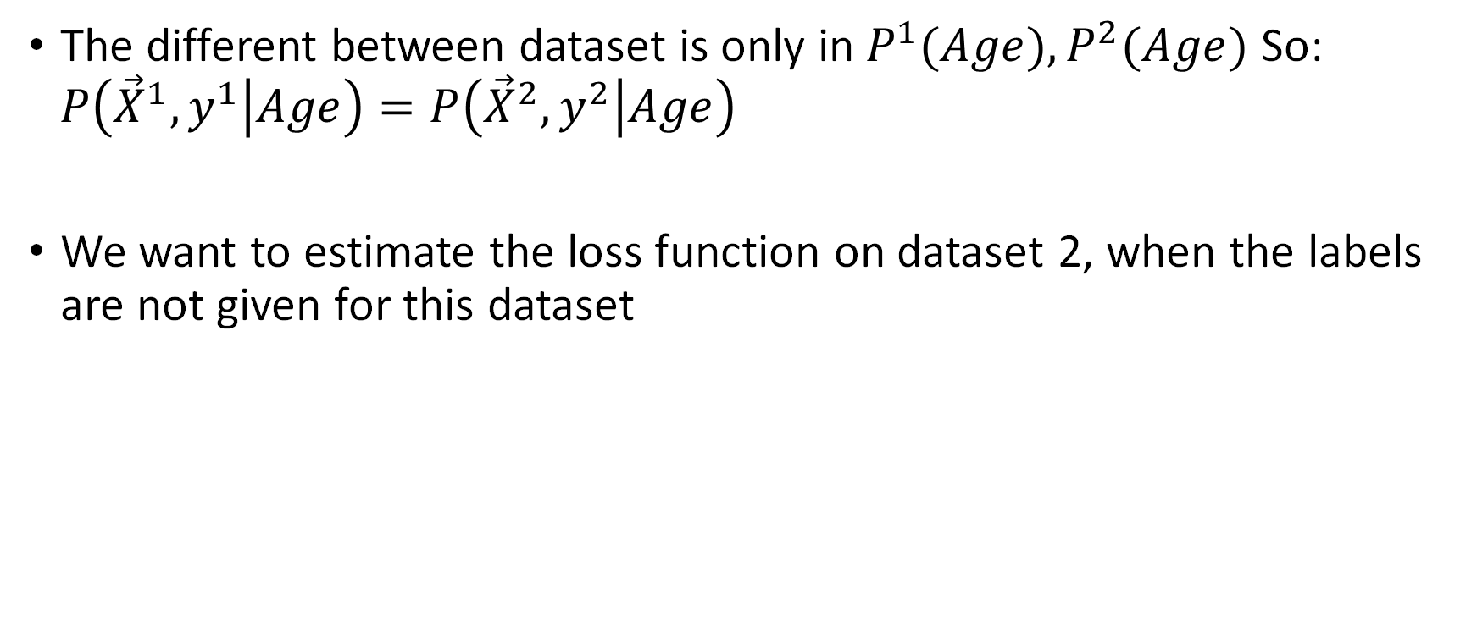
Continue
The different between dataset is only in $P^{1}(Age),P^{2}(Age)$ So: $P\left({\vec{X}}^{1},y^{1} | Age\right)=P\left({\vec{X}}^{2},y^{2} | Age\right)$
We want to estimate the loss function on dataset 2, when the labels are not given for this dataset

